Slide 1
Spring MVC
Spring MVC

Slide 2
Spring MVC
Spring MVC provides an elegant solution to use MVC in spring framework by the help of DispatcherServlet.
In Spring Web MVC, DispatcherServlet class works as the front controller. It is responsible to manage the flow of the spring mvc application.
The @Controller annotation is used to mark the class as the controller in from Spring 3.
The @RequestMapping annotation is used to map the request URL. It is applied on the method.

Slide 3
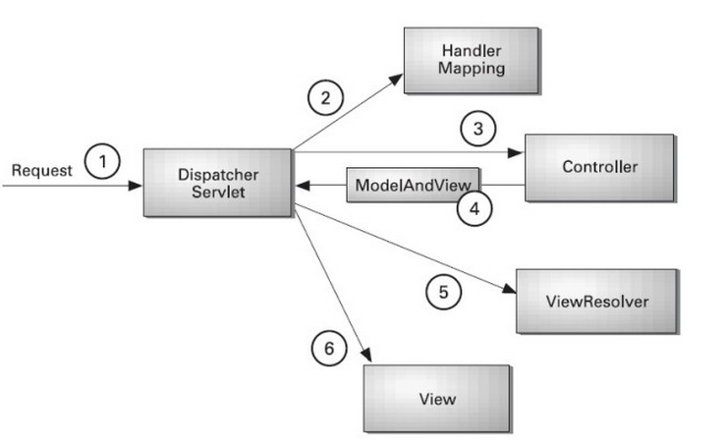
***Spring Web MVC - Architecture

Slide 4
Explanation
All the incoming request is intercepted by the DispatcherServlet that works as the front controller.
The DispatcherServlet gets entry of handler mapping from the xml file and forwards the request to the controller.
The controller returns an object of ModelAndView.
The DispatcherServlet checks the entry of view resolver in the xml file and invokes the specified view component.

Slide 5
Spring MVC Example

Slide 6
7 steps for creating the spring MVC application
Create the request page (optional)
Create the controller class
Provide the entry of controller in the web.xml file
Define the bean in the xml file
Display the message in the JSP page
Load the spring core and mvc jar files
Start server and deploy the project

Slide 7
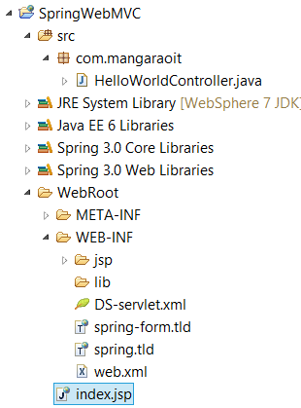
Directory Structure

Slide 8
Required Jar files
To run this example, you need to load:
Spring Core jar files
Spring Web jar files

Slide 9
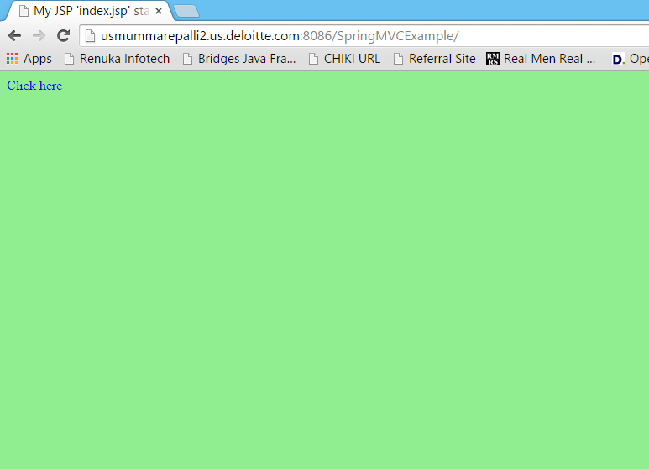
Request Screen

Slide 10
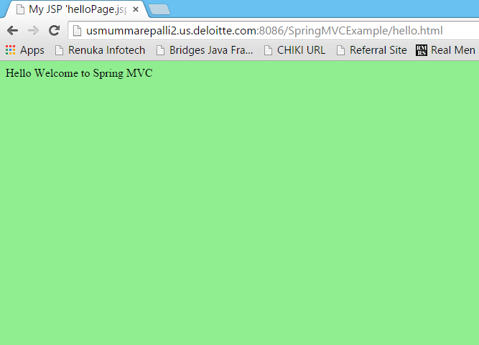
Output Screen

Slide 11
Source code developed by MyEclipse IDE

Slide 12
1) Create the request page (optional)
This is the simple jsp page containing a link. It is optional page. You may direct invoke the action class instead.

Slide 13
index.jsp
<a href="hello.html">click</a>

Slide 14
2) Create the controller class
To create the controller class, we are using two annotations @Controller and @RequestMapping.
The @Controller annotation marks this class as Controller.
The @Requestmapping annotation is used to map the class with the specified name.
This class returns the instance of ModelAndView controller with the mapped name, message name and message value. The message value will be displayed in the jsp page.

Slide 15
HelloWorldController.java
package com.myit;
import org.springframework.stereotype.Controller;
import org.springframework.web.bind.annotation.RequestMapping;
import org.springframework.web.servlet.ModelAndView;
@Controller
public class HelloWorldController {
@RequestMapping("/hello")
public ModelAndView helloWorld() {
String message = "HELLO SPRING MVC HOW R U";
return new ModelAndView("hellopage", "message", message);
}
}

Slide 16
3) Provide the entry of controller in the web.xml file
In this xml file, we are specifying the servlet class DispatcherServlet that acts as the front controller in Spring Web MVC.
All the incoming request for the html file will be forwarded to the DispatcherServlet.

Slide 17
web.xml
<web-app>
<servlet>
<servlet-name>spring</servlet-name>
<servlet-class>org.springframework.web.servlet.DispatcherServlet</servlet-class>
<load-on-startup>1</load-on-startup>
</servlet>
<servlet-mapping>
<servlet-name>spring</servlet-name>
<url-pattern>*.html</url-pattern>
</servlet-mapping>
</web-app>

Slide 18
4) Define the bean in the xml file
This is the important configuration file where we need to specify the ViewResolver and View components.
The context:component-scan element defines the base-package where DispatcherServlet will search the controller class.
Here, the InternalResourceViewResolver class is used for the ViewResolver.
The prefix+string returned by controller+suffix page will be invoked for the view component.
This xml file should be located inside the WEB-INF directory.

Slide 19
spring-servlet.xml
<?xml version="1.0" encoding="UTF-8"?>
<beans xmlns="http://www.springframework.org/schema/beans"
xmlns:xsi="http://www.w3.org/2001/XMLSchema-instance"
xmlns:p="http://www.springframework.org/schema/p"
xmlns:context="http://www.springframework.org/schema/context"
xsi:schemaLocation="http://www.springframework.org/schema/beans
http://www.springframework.org/schema/beans/spring-beans-3.0.xsd
http://www.springframework.org/schema/context
http://www.springframework.org/schema/context/spring-context-3.0.xsd">
<context:component-scan base-package="com.myit" />
<bean class="org.springframework.web.servlet.view.InternalResourceViewResolver">
<property name="prefix" value="/WEB-INF/jsp/" />
<property name="suffix" value=".jsp" />
</bean>
</beans>

Slide 20
5) Display the message in the JSP page
This is the simple JSP page, displaying the message returned by the Controller.
It must be located inside the WEB-INF/jsp directory for this example only.

Slide 21
hellopage.jsp
${message}

Slide 22
Spring 3 MVC Multiple Controller Example
Multi Controller Example

Slide 23
Spring 3 MVC Multiple Controller Example
We can have a lot of controller classes in Spring Framework. In this example, we are creating two Controller classes
1. HelloWorldController
2. WelcomeWorldController.

Slide 24
1) Controller Classes

Slide 25
HelloWorldController.java
@Controller
public class HelloWorldController {
@RequestMapping("/hello")
public ModelAndView helloWorld() {
String message = "HELLO SPRING MVC";
return new ModelAndView("hellopage", "message", message);
}
}

Slide 26
WelcomeWorldController.java
@Controller
public class WelcomeWorldController {
@RequestMapping("/welcome")
public ModelAndView helloWorld() {
String message = "WELCOME SPRING MVC";
return new ModelAndView("welcomepage", "message", message);
}
}

Slide 27
2) View components

Slide 28
helloPage.jsp
Message is: ${message}

Slide 29
welcomePage.jsp
Message is: ${message}

Slide 30
Spring MVC Request Response Example
We can simply create login application by following the Spring MVC. We need to pass HttpServletRequest and HttpServletResponse objects in the request processing method of the Controller class. Let's see the example:

Slide 31
Spring MVC Login Example

Slide 32
Login Example
We need to pass HttpServletRequest and HttpServletResponse objects in the request processing method of the Controller class.

Slide 33
1) Controller Class

Slide 34
HelloWorldController.java
@Controller
public class LoginController {
@RequestMapping("/hello")
public ModelAndView helloWorld(HttpServletRequest request,HttpServletResponse res) {
String name=request.getParameter("name");
String password=request.getParameter("password");
if(password.equals("admin")){
String message = "HELLO "+name;
return new ModelAndView("hellopage", "message", message);
}
else{
return new ModelAndView("errorpage", "message","Sorry, username or password error");
}
}
}

Slide 35
2) View components

Slide 36
hellpPage.jsp
${message}

Slide 37
errorPage.jsp
${message}
<jsp:include page="/index.jsp"></jsp:include>

Slide 38
3) Index page
<form action="hello.html" method="post">
Name:<input type="text" name="name"/><br/>
Password:<input type="password" name="password"/><br/>
<input type="submit" value="login"/>
</form>

Slide 39
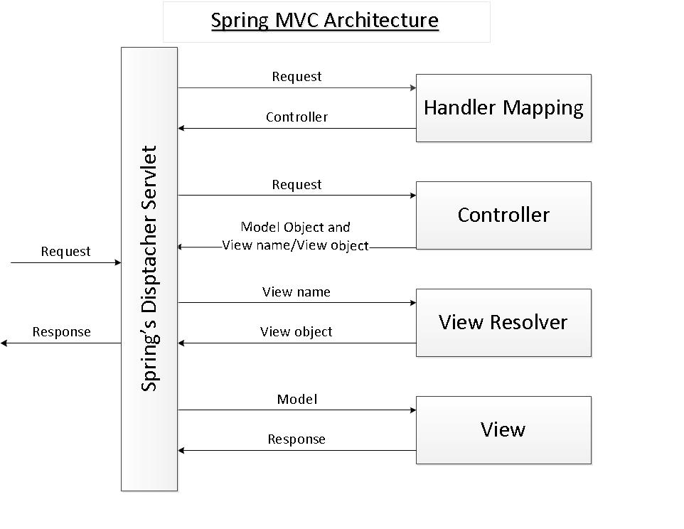
A brief overview about Spring MVC

Slide 40
As its name says, the Spring MVC framework is based on the Model - View - Controller (MVC) design pattern which separates the application’s logic into the three layers Mode, View and Controller. MVC is implemented in Spring by the following components:
Spring’s dispatcher servlet: acts as a front controller between the Spring application and its clients. The dispatcher servlet intercepts all requests coming to the application and consults the Handler Mapping for which controller to be invoked to handle the requests.
Handler Mapping: is responsible to find appropriate controllers that handle specific requests. The mapping between request URLs and controller classes is done via XML configuration or annotations.
Controller: is responsible to process the requests by calling other business/service classes. The output can be attached to model objects which will be sent to the view. To know which view will be rendered, the controller consults the View Resolver.
View Resolver: finds the physical view files from the logical names.
View: physical view files which can be JSP, HTML, XML, Velocity template, etc.

Slide 41
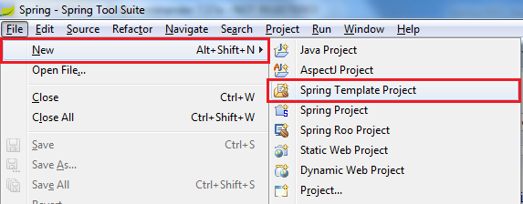
Creating a Spring MVC project in Spring Tool Suite IDE
Now let’s play with the Spring Tool Suite IDE to see how it leverages Spring application development.
Start STS in your own workspace and make sure the current perspective is Spring (default). From main menu, select File > New > Spring Template Project:

Slide 42
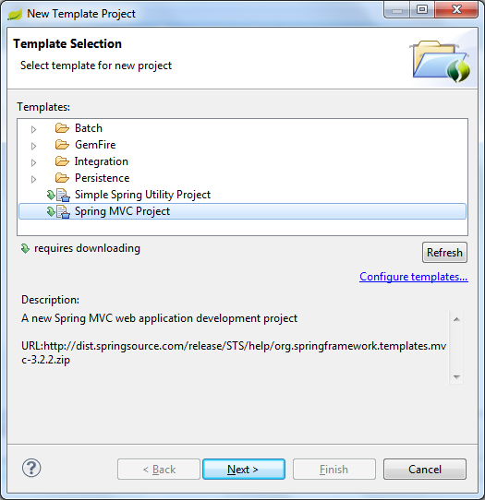
In the New Template Project dialog, select Spring MVC Project

Slide 43
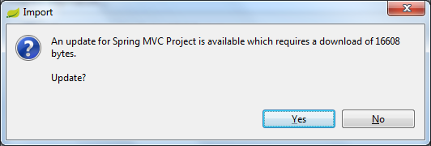
Click Next, it requires downloading an update of the template (for the first time you use this template or whenever an update available):

Slide 44
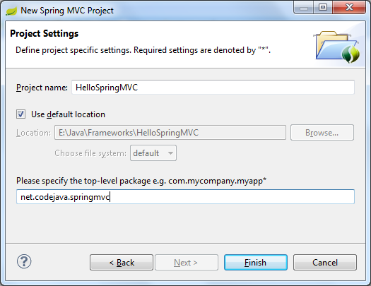
Click Yes to download the update, it should process quickly and then bring the New Spring MVC Project: In this dialog, enter the following information: Project name: HelloSpringMVC Top-level package: some package name

Slide 45
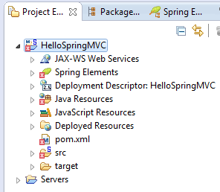
NOTE: Be careful when selecting the package name, because the last element (springmvc in net.codejava.springmvc) will be used as artifactId in Maven project file (pom.xml) and as context path of the application. However we can change this in the pom.xml file (which will be discussed later in this tutorial). Click Finish, STS will create a Spring MVC-based project with some defaults for controller, views and configuration. You may get the errors in the Project Explorer/Package Explorer like this:

Slide 46
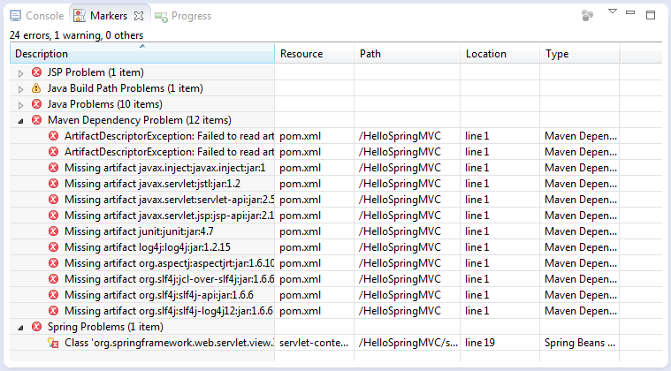
And errors in the Markers views like this:

Slide 47
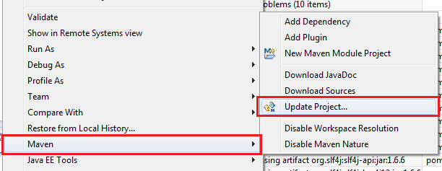
Don’t worry, that’s because Maven hasn’t update some dependencies yet. We are going to fix these errors right now. Right click on project name in the Project Explorer view, select Maven > Update Project… from the context menu:

Slide 48
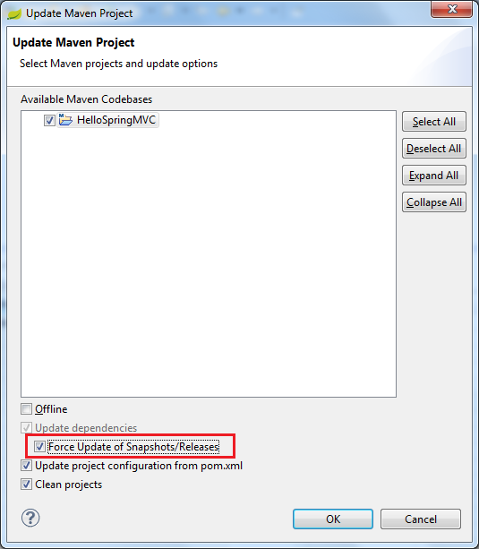
In the Update Maven Project dialog, select the checkbox Force Update of Snapshots/Releases:

Slide 49
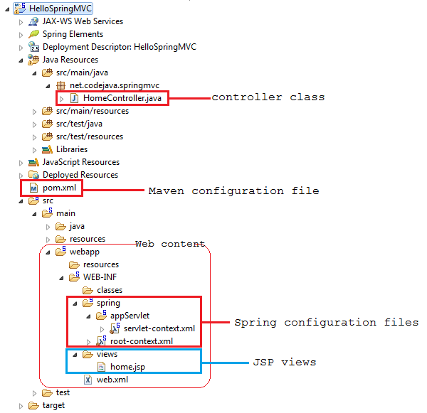
Click Finish, wait a while for Maven downloading the required dependencies then the errors will be gone away. Now let’s explore what has been created by the Spring MVC Project template. Expand the branches in the Project Explorerview, we would see the project is structured like this:

Slide 50
As we can see, STS created all the nuts and bolts for a typical Spring MVC application: XML configuration, jar dependencies, an example controller, and an example JSP view. Let’s look at these pieces in more details.

Slide 51
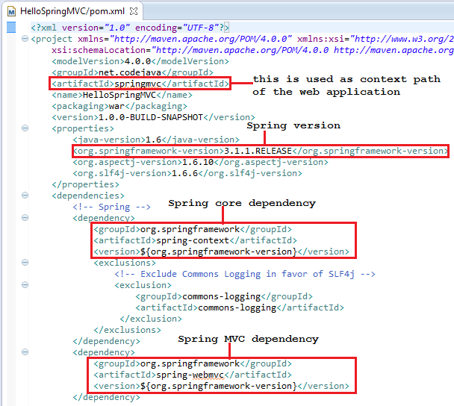
Maven dependencies configuration Here’s a partial content of the pom.xml file:

Slide 52
The generated pom.xml file includes all necessary dependencies for Spring core and Spring MVC, as well as servlet API, logging, etc. The noteworthy points are marked by red rectangles in the screenshot above.
Value of the artifactId element will be used as context path of the web application when deploying the project on a server running within the IDE. That means we will access this application in the following form:
http://localhost:port/springmvc
If we want to change version of Spring framework, just updating value of the org.springframework-version element. Because the version 3.1.1.RELEASE is not the latest, change it to the latest release 3.2.2.RELEASE (at writing time) as follows:
<org.springframework-version>3.2.2.RELEASE</org.springframework-version>
Just by saving the pom.xml file, Maven will detect the change and updates all the related dependencies immediately.

Slide 53
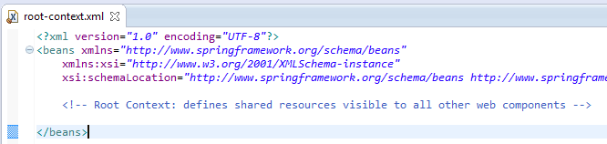
Spring MVC configuration STS created two Spring configuration files: root-context.xml and servlet-context.xml.
root-context.xml:
This specifies configuration for root Spring container which are shared by all servlets and filters. The root-context.xml file is loaded by the Spring’s ContextLoaderListener upon application’s startup. This file is empty by default.

Slide 54
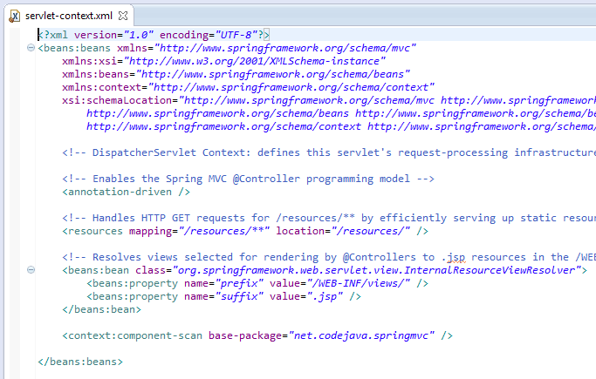
servlet-context.xml:

Slide 55
This file is loaded by the Spring’s DispatcherServlet which receives all requests coming into the application and dispatches processing for controllers, based on the configuration specified in this servlet-context.xml file. Let’s look at some default configurations:
<annotation-driven />: tells the framework to use annotations-based approach to scan files in the specified packages. Thus we can use the @Controller annotation for the controller class, instead of declaring XML elements.
<resources mapping=…/>: maps static resources directly with HTTP GET requests. For example images, javascript, CSS,.. resources do not have to go through controllers.
Bean InternalResourceViewResolver: this bean declaration tells the framework how to find physical JSP files according to logical view names returned by the controllers, by attaching the prefix and the suffix to a view name. For example, if a controller’s method returns “home” as logical view name, then the framework will find a physical file “home.jsp” under the /WEB-INF/views directory.
<context:component-scan …/>: tell the framework which packages to be scanned when using annotation-based strategy. Here the framework will scan all classes under the package net.codejava.springmvc.
When the application grows up, we will put more configurations for business beans, DAOs, transactions, etc.

Slide 56
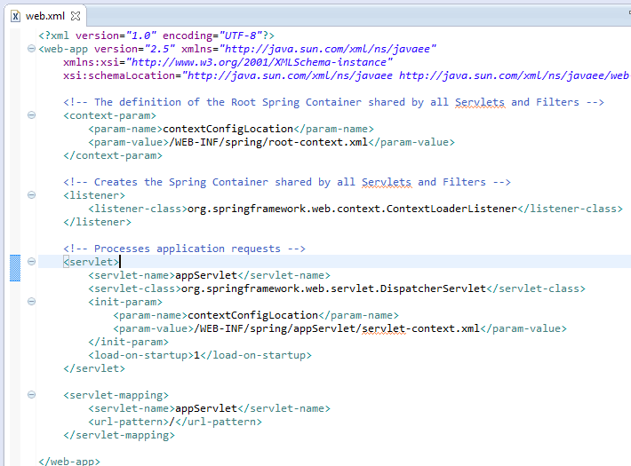
Web deployment descriptor (web.xml)
Here is content of the generated web.xml file:

Slide 57
This is the typical configuration for a Spring MVC-based application with declaration for Spring’s ContextLoaderListenerand DispatcherServlet along with the Spring configuration files root-context.xml and servlet-context.xml. Finally, it specifies the URL mapping for Spring’s DispatcherServlet to handle all requests.

Slide 58
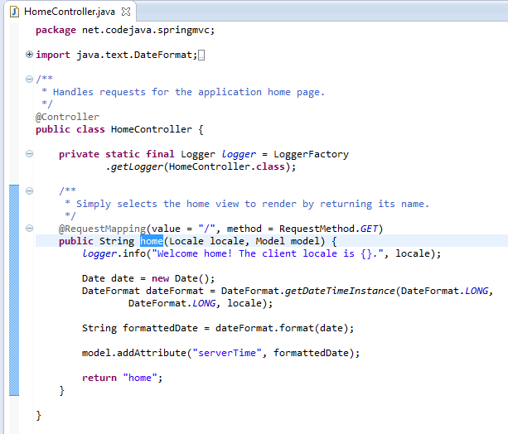
The example controller: HomeController.java Following is the generated code of the controller class:

Slide 59
As we can see, the @Controller annotation is used to specify this class is a Spring controller, and the @RequestMappingannotation specifies that the home() method will handle a GET request with the URL / (default page of the application). In one controller class we can write many methods to handle different URLs.
Inside the home() method, it creates a String object to hold the current date based on the current locale, and adds this object to the model with the name “serverTime”:
model.addAttribute("serverTime", formattedDate);
And finally the method returns a view named “home”, which will be resolved by the view resolver specified in the servlet-context.xml file, to find the actual view file.

Slide 60
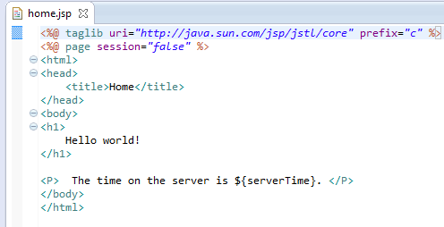
The example JSP view: home.jsp The home.jsp file is generated under /WEB-INF/views directory with the following content:

Slide 61
This code is very simple, it just prints out value of the variable “serverTime” which is passed by the controller, using an EL expression:
The time on the server is ${serverTime}.
So far we have gone through all the stuffs generated by the Spring MVC Project template. Notice we haven’t written any line of code yet, but the application is ready to be deployed and tested now. Let’s go!

Slide 62

Deploying and running the application In Spring Tool Suite IDE, switch to the Servers view. Probably you should see the VMWare vFabric tc Server like this:
If you don’t see any server, follow these steps to add one:
Right click inside the Servers view then select New > Server from the context menu (Or click on the link new server wizard, if this link available):

Slide 63
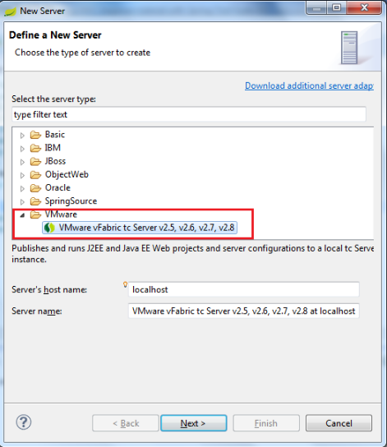
In the New Server dialog, select VMware > VMware vFabric tc Server…as follows:

Slide 64
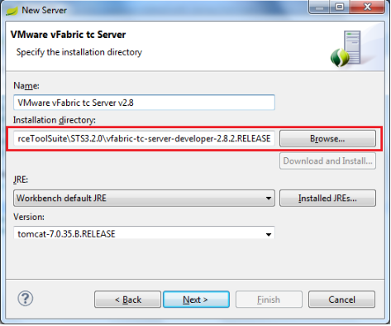
Click Next, you may have to select installation directory for the server For a STS installation, the server usually installed in the following directory: STS_HOME\vfabric-tc-server-developer-VERSION

Slide 65
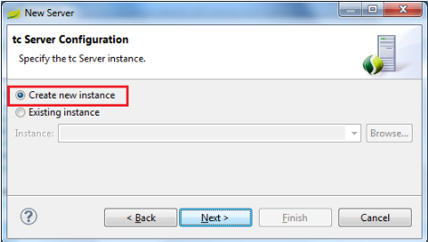
Click Next. In the next screen, keep the option Create a new instanceselected:

Slide 66
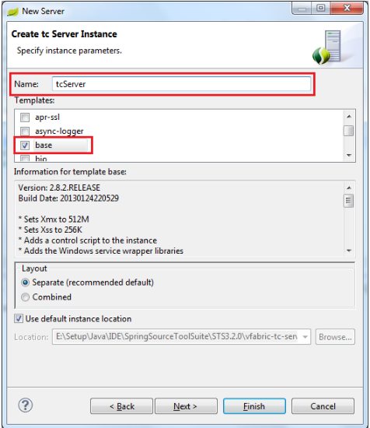
Click Next. In the next screen, type tcServer as name for the new instance and select base as the template:

Slide 67
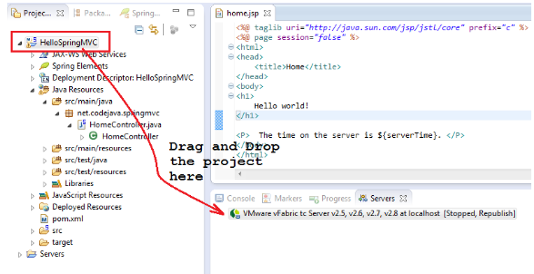
Click Finish, to complete the server setup and you should see the server appears in the Servers view. Now deploy our HelloSpringMVC application as simple as drag-n-drop the project to the server:

Slide 68

The application is deployed on the server if we see it beneath the server name like this:

Slide 69
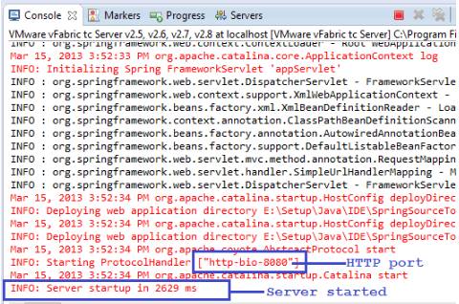
Start the server by right clicking on the server name then select Start from the context menu (or click on the start icon). Wait for seconds while the server is starting, you should see some verbose output in the Console view:

Slide 70
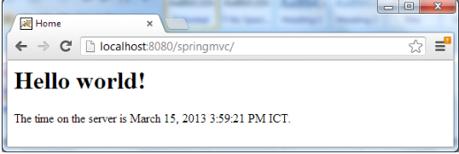
Notice the last line indicates the server has been started without any problem. Open a web browser window and type the following URL into its address bar: http://localhost:8080/springmvc If everything is going well (of course), we would see following screen:

Slide 71
Congratulations! We have got our first Spring MVC application running, it prints the current date time on the server. If you refresh the page, you should see the time changes.

Slide 72

Modifying the project
So far we have tested and seen the generated application running. Now let’s add some changes to the project for further understanding Spring MVC.
Add the following method into the HomeController.java class:
This method will handle requests having the URL pattern /test and does the following chore:
Adds a String object as an attribute into the model with name “message” and value is “Greetings, Spring MVC!”.
Returns a logical view named “test”.
Because the test() method returns “test” view name

Slide 73
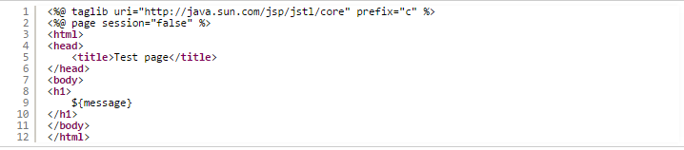
following the configuration specified by the view resolver, we have to create a JPS file called test.jsp under /WEB-INF/views directory, with the following content:
This page is deadly simple, as it prints out value of the variable “message” which will be passed by the controller.

Slide 74
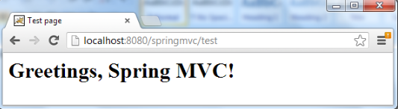
Now get back to the browser window, change the URL to: http://localhost:8080/springmvc/test

Slide 75
Hurrah! We have finished walking through a quite long journey with Spring Tool Suite IDE and our first Spring MVC application.
Source: http://www.codejava.net/frameworks/spring/spring-mvc-beginner-tutorial-with-spring-tool-suite-ide

Slide 76
Spring MVC CRUD Example
CRUD (Create, Read, Update and Delete) application is the most important application for creating any project. It provides an idea to develop a large project. In spring MVC, we can develop a simple CRUD application.
Here, we are using JdbcTemplate for database interaction.
Required Jar files
To run this example, you need to load:
Spring Core jar files
Spring Web jar files
ojdbc14.jar file for oracle

Slide 77
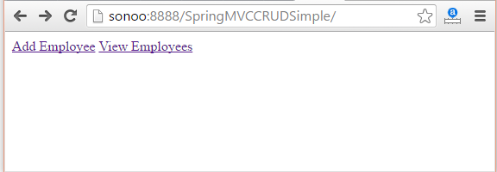

Slide 78
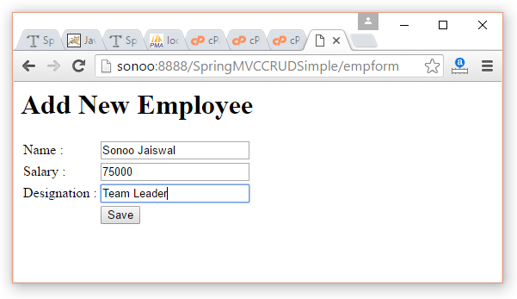
Click on Save, Employee list can be seen in other screen

Slide 79
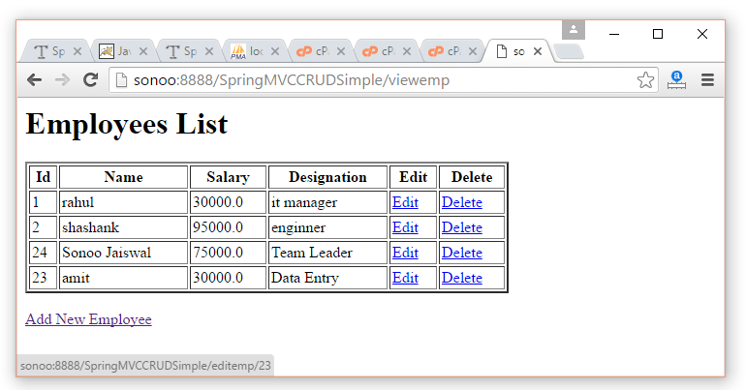
Click on Edit, a form will appear with data

Slide 80
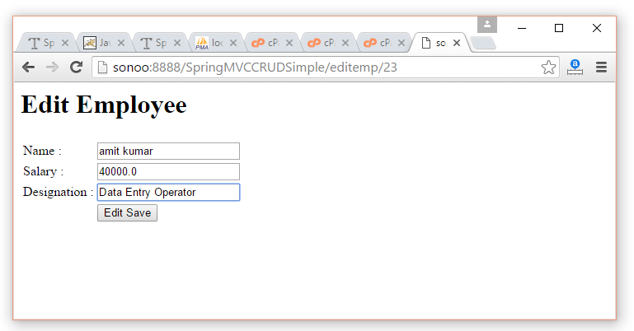
Now change the form data and click on Edit save

Slide 81
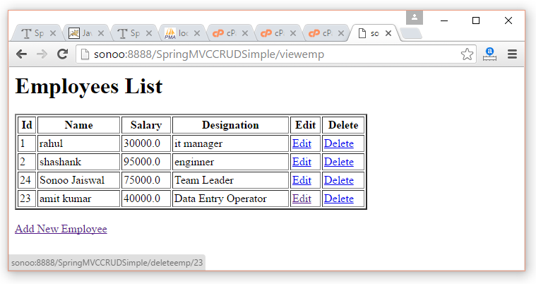
Now click on Delete link, you will see employee list with deleted record

Slide 82
Files
index.jsp
Emp.java
EmpDao.java
EmpController.java
web.xml
Spring-servlet.xml
empform.jsp
empeditform.jsp
viewemp.java

Slide 83
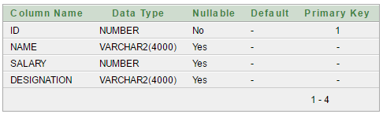
Create table
Here, we are using Emp table of oracle 11g database which has 4 fields: id, name, salary and designation. Here, id is auto incremented which is generated by sequence.

Slide 84
index.jsp
<a href="empform">Add Employee</a>
<a href="viewemp">View Employees</a>

Slide 85
Employee
package com.mangaraoit.beans;
public class Emp {
private int id;
private String name;
private float salary;
private String designation;
//setters and getters
}

Slide 86
EmployeeDao.java
package com.mangaraoit.dao;
public class EmpDao {
JdbcTemplate template;
public void setTemplate(JdbcTemplate template) {
this.template = template;
}
public int save(Emp p){
String sql="insert into Emp(name,salary,designation)
values('"+p.getName()+"',"+p.getSalary()+",'"+p.getDesignation()+"')";
return template.update(sql);
}
public int update(Emp p){
String sql="update Emp set name='"+p.getName()+"', salary="+p.getSalary()+",
designation='"+p.getDesignation()+"' where id="+p.getId()+"";
return template.update(sql);
}
public int delete(int id){
String sql="delete from Emp where id="+id+"";
return template.update(sql);
}

Slide 87
public Emp getEmpById(int id){
String sql="select * from Emp where id=?";
return template.queryForObject(sql, new Object[]{id},new BeanPropertyRowMapper<Emp>(Emp.class));
}
public List<Emp> getEmployees(){
return template.query("select * from Emp",new RowMapper<Emp>(){
public Emp mapRow(ResultSet rs, int row) throws SQLException {
Emp e=new Emp();
e.setId(rs.getInt(1));
e.setName(rs.getString(2));
e.setSalary(rs.getFloat(3));
e.setDesignation(rs.getString(4));
return e;
}
});
}
}

Slide 88
EmpController.java
package com.mangaraoit.controllers;
@Controller
public class EmpController {
@Autowired
EmpDao dao;//will inject dao from xml file
/*It displays a form to input data, here "command" is a reserved request attribute
*which is used to display object data into form
*/
@RequestMapping("/empform")
public ModelAndView showform(){
return new ModelAndView("empform","command",new Emp());
}
/*It saves object into database. The @ModelAttribute puts request data
* into model object. You need to mention RequestMethod.POST method
* because default request is GET*/
@RequestMapping(value="/save",method = RequestMethod.POST)
public ModelAndView save(@ModelAttribute("emp") Emp emp){
dao.save(emp);
return new ModelAndView("redirect:/viewemp");//will redirect to viewemp request mapping
}

Slide 89
/* It provides list of employees in model object */
@RequestMapping("/viewemp")
public ModelAndView viewemp(){
List<Emp> list=dao.getEmployees();
return new ModelAndView("viewemp","list",list);
}
/* It displays object data into form for the given id.
* The @PathVariable puts URL data into variable.*/
@RequestMapping(value="/editemp/{id}")
public ModelAndView edit(@PathVariable int id){
Emp emp=dao.getEmpById(id);
return new ModelAndView("empeditform","command",emp);
}
/* It updates model object. */
@RequestMapping(value="/editsave",method = RequestMethod.POST)
public ModelAndView editsave(@ModelAttribute("emp") Emp emp){
dao.update(emp);
return new ModelAndView("redirect:/viewemp");
}
/* It deletes record for the given id in URL and redirects to /viewemp */
@RequestMapping(value="/deleteemp/{id}",method = RequestMethod.GET)
public ModelAndView delete(@PathVariable int id){
dao.delete(id);
return new ModelAndView("redirect:/viewemp");
} }

Slide 90
Web.xml
<servlet>
<servlet-name>spring</servlet-name>
<servlet-class>org.springframework.web.servlet.DispatcherServlet</servlet-class>
<load-on-startup>1</load-on-startup>
</servlet>
<servlet-mapping>
<servlet-name>spring</servlet-name>
<url-pattern>/</url-pattern>
</servlet-mapping>

Slide 91
spring-servlet.xml
<context:component-scan base-package="com.mangaraoit.controllers"></context:component-scan>
<bean class="org.springframework.web.servlet.view.InternalResourceViewResolver">
<property name="prefix" value="/WEB-INF/jsp/"></property>
<property name="suffix" value=".jsp"></property>
</bean>
<bean id="ds" class="org.springframework.jdbc.datasource.DriverManagerDataSource">
<property name="driverClassName" value="oracle.jdbc.driver.OracleDriver"></property>
<property name="url" value="jdbc:oracle:thin:@localhost:1521:xe"></property>
<property name="username" value="system"></property>
<property name="password" value="oracle"></property>
</bean>
<bean id="jt" class="org.springframework.jdbc.core.JdbcTemplate">
<property name="dataSource" ref="ds"></property>
</bean>
<bean id="dao" class="com.mangaraoit.dao.EmpDao">
<property name="template" ref="jt"></property>
</bean>
</beans>

Slide 92
empform.jsp
<%@ taglib uri="http://www.springframework.org/tags/form" prefix="form"%>
<%@ taglib uri="http://java.sun.com/jsp/jstl/core" prefix="c"%>
<h1>Add New Employee</h1>
<form:form method="post" action="save">
<table >
<tr>
<td>Name : </td>
<td><form:input path="name" /></td>
</tr>
<tr>
<td>Salary :</td>
<td><form:input path="salary" /></td>
</tr>
<tr>
<td>Designation :</td>
<td><form:input path="designation" /></td>
</tr>
<tr>
<td> </td>
<td><input type="submit" value="Save" /></td>
</tr>
</table>
</form:form>

Slide 93
empeditform.jsp
<%@ taglib uri="http://www.springframework.org/tags/form" prefix="form"%>
<%@ taglib uri="http://java.sun.com/jsp/jstl/core" prefix="c"%>
<h1>Edit Employee</h1>
<form:form method="POST" action="/SpringMVCCRUDSimple/editsave">
<table > <tr>
<td></td>
<td><form:hidden path="id" /></td>
</tr>
<tr>
<td>Name : </td>
<td><form:input path="name" /></td>
</tr>
<tr>
<td>Salary :</td>
<td><form:input path="salary" /></td>
</tr>
<tr>
<td>Designation :</td>
<td><form:input path="designation" /></td>
</tr>
<tr>
<td> </td>
<td><input type="submit" value="Edit Save" /></td>
</tr>
</table>
</form:form>

Slide 94
viewemp.jsp
<%@ taglib uri="http://www.springframework.org/tags/form" prefix="form"%>
<%@ taglib uri="http://java.sun.com/jsp/jstl/core" prefix="c"%>
<h1>Employees List</h1>
<table border="2" width="70%" cellpadding="2">
<tr><th>Id</th><th>Name</th><th>Salary</th><th>Designation</th><th>Edit</th><th>Delete</th></tr>
<c:forEach var="emp" items="${list}">
<tr>
<td>${emp.id}</td>
<td>${emp.name}</td>
<td>${emp.salary}</td>
<td>${emp.designation}</td>
<td><a href="editemp/${emp.id}">Edit</a></td>
<td><a href="deleteemp/${emp.id}">Delete</a></td>
</tr>
</c:forEach>
</table>
<br/>
<a href="empform">Add New Employee</a>

Slide 95
Spring MVC Tiles Example
Spring provides integration support with apache tiles framework.
So we can simply manage the layout of the spring mvc application by the help of spring tiles support.
Advantage of Tiles support in Spring MVC
Reusability: We can reuse a single component in multiple pages like header and footer components.
Centralized control: We can control the layout of the page by a single template page only.
Easy to change the layout: By the help of single template page, we can change the layout of the page anytime. So your website can easily adapt new technologies such as bootstrap, jquery etc.

Slide 96
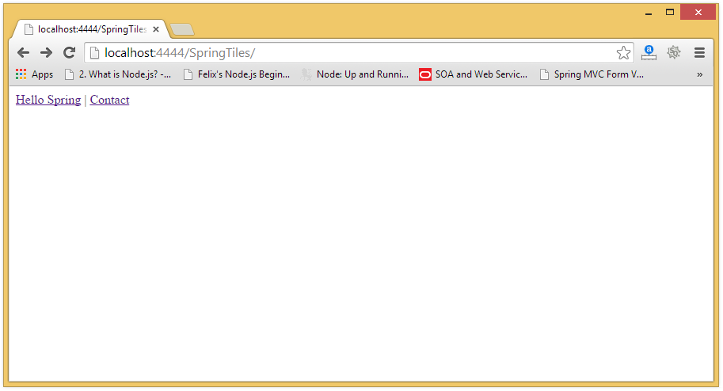

Slide 98
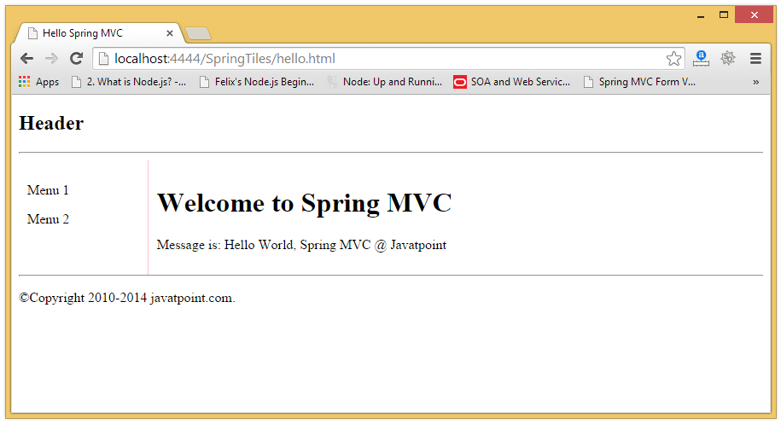

Slide 99
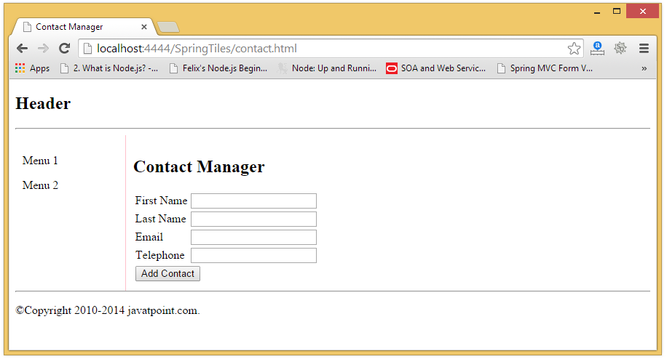

Slide 100
Required Jar files
Spring Core jar files
Spring Web jar files
Tiles jar files

Slide 101
Index Page - index.jsp
<a href="hello.html">Hello Spring</a> |
<a href="contact.html">Contact</a>

Slide 102
Controller classes
HelloWorldController.java
ContactController.java

Slide 103
HelloWorldController.java
package com.mangaraoit.controller;
import org.springframework.stereotype.Controller;
import org.springframework.web.bind.annotation.RequestMapping;
import org.springframework.web.servlet.ModelAndView;
@Controller
public class HelloWorldController {
@RequestMapping("/hello")
public ModelAndView helloWorld() {
String message = "Hello World, Spring MVC @ mangaraoit";
return new ModelAndView("hello", "message", message);
}
}

Slide 104
ContactController.java
package com.mangaraoit.controller;
import com.mangaraoit.form.Contact;
@Controller
@SessionAttributes
public class ContactController {
@RequestMapping(value = "/addContact", method = RequestMethod.POST)
public String addContact(@ModelAttribute("contact") Contact contact, BindingResult result) {
//write the code here to add contact
return "redirect:contact.html";
}
@RequestMapping("/contact")
public ModelAndView showContacts() {
return new ModelAndView("contact", "command", new Contact());
}
}

Slide 105
Form class – Contact.java
package com.mangaraoit.form;
public class Contact {
private String firstname;
private String lastname;
private String email;
private String telephone;
//getters and setters
}

Slide 106
web.xml
<servlet>
<servlet-name>spring</servlet-name>
<servlet-class>org.springframework.web.servlet.DispatcherServlet</servlet-class>
<load-on-startup>1</load-on-startup>
</servlet>
<servlet-mapping>
<servlet-name>spring</servlet-name>
<url-pattern>*.html</url-pattern>
</servlet-mapping>

Slide 107
spring-servlet.xml file
This is the important configuration file where we need to specify the ViewResolver and View components.
The context:component-scan element defines the base-package where DispatcherServlet will search the controller class.
Here, the UrlBasedViewResolver class is used for the ViewResolver.
The prefix+string returned by controller+suffix page will be invoked for the view component.
This xml file should be located inside the WEB-INF directory.

Slide 108
spring-servlet.xml
<context:component-scan
base-package="com.mangaraoit.controller" />
<bean id="viewResolver"
class="org.springframework.web.servlet.view.UrlBasedViewResolver">
<property name="viewClass">
<value>
org.springframework.web.servlet.view.tiles2.TilesView
</value>
</property>
</bean>
<bean id="tilesConfigurer"
class="org.springframework.web.servlet.view.tiles2.TilesConfigurer">
<property name="definitions">
<list>
<value>/WEB-INF/tiles.xml</value>
</list>
</property>
</bean>

Slide 109
tiles.xml
<!DOCTYPE tiles-definitions PUBLIC
"-//Apache Software Foundation//DTD Tiles Configuration 2.0//EN"
"http://tiles.apache.org/dtds/tiles-config_2_0.dtd">
<tiles-definitions>
<definition name="base.definition"
template="/WEB-INF/jsp/layout.jsp">
<put-attribute name="title" value="" />
<put-attribute name="header" value="/WEB-INF/jsp/header.jsp" />
<put-attribute name="menu" value="/WEB-INF/jsp/menu.jsp" />
<put-attribute name="body" value="" />
<put-attribute name="footer" value="/WEB-INF/jsp/footer.jsp" />
</definition>
<definition name="contact" extends="base.definition">
<put-attribute name="title" value="Contact Manager" />
<put-attribute name="body" value="/WEB-INF/jsp/contact.jsp" />
</definition>
<definition name="hello" extends="base.definition">
<put-attribute name="title" value="Hello Spring MVC" />
<put-attribute name="body" value="/WEB-INF/jsp/hello.jsp" />
</definition>
</tiles-definitions>

Slide 110
hello.jsp
<html>
<head>
<title>Spring MVC Example</title>
</head>
<body>
<h1>Welcome to Spring MVC</h1>
<p>Message is: ${message}</p>
</body>
</html>

Slide 111
contact.jsp
<%@taglib uri="http://www.springframework.org/tags/form" prefix="form"%>
<html>
<head>
<title>Spring Tiles Contact Form</title>
</head>
<body>
<h2>Contact Manager</h2>
<form:form method="post" action="addContact.html">
<table>
<tr>
<td><form:label path="firstname">First Name</form:label></td>
<td><form:input path="firstname" /></td>
</tr>
<tr>
<td><form:label path="lastname">Last Name</form:label></td>
<td><form:input path="lastname" /></td>
</tr>

Slide 112
<tr>
<td><form:label path="lastname">Email</form:label></td>
<td><form:input path="email" /></td>
</tr>
<tr>
<td><form:label path="lastname">Telephone</form:label></td>
<td><form:input path="telephone" /></td>
</tr>
<tr>
<td colspan="2">
<input type="submit" value="Add Contact"/>
</td>
</tr></table>
/form:form>
</body>
</html>

Slide 113
header.jsp
<h2>Header</h2>
<hr/>
footer.jsp
<hr/>
<p>Copyright 2010-2014 mangaraoit.com.</p>
menu.jsp
<p>Menu 1</p>
<p>Menu 2</p>

Slide 114
layout.jsp
<%@ taglib uri="http://tiles.apache.org/tags-tiles" prefix="tiles"%>
<!DOCTYPE HTML PUBLIC "-//W3C//DTD HTML 4.01 Transitional//EN"
"http://www.w3.org/TR/html4/loose.dtd">
<html>
<head>
<meta http-equiv="Content-Type" content="text/html; charset=UTF-8">
<title><tiles:insertAttribute name="title" ignore="true" /></title>
</head>
<body>
<div><tiles:insertAttribute name="header" /></div>
<div style="float:left;padding:10px;width:15%;">
<tiles:insertAttribute name="menu" />
</div>
<div style="float:left;padding:10px;width:80%;border-left:1px solid pink;">
<tiles:insertAttribute name="body" />
</div>
<div style="clear:both"><tiles:insertAttribute name="footer" /></div>
</body>
</html>

Slide 115
Spring WEB
The web module is the module that enables you to write an web application using the spring container without xml.
There two ways of creating spring context in web application
1. Via Listener(ContextLoaderListener)
2. via Servlet(ContextLoaderServlet)
To use it you just need to configure the web.xml. just add the following lines in web.xml file

Slide 116
web.xml contextConfigLocation is the parameter name to specify spring configuration file location
<web-app> <context-param> <param-name>contextConfigLocation</param-name> <param-value>/WEB-INF/SpringConfiguration.xml</param-value> </context-param> <listener> <listener-class>org.springframework.web.context.ContextLoaderListener</listener-class> </listener> <!-- <servlet> <servlet-name>SpringContainerCreatorServlet</servlet-name> <servlet-class>org.springframework.web.context.ContextLoaderServlet</servlet-class> </servlet>--> </web-app>

Slide 117
***Difference between Spring Web and Spring MVC
The Spring web module provides some basic utility classes for web applications and also provides integration points with Struts and JSF. But, by itself, the web module doesn't provide an MVC implementation.
The Spring MVC module is a subframework built upon Spring and the Spring Web Module providing a complete alternative to other MVC implementations. So, if you're using Struts in your presentation layer and Spring in the service layer, you'll be using the Spring Web Module, but not the Spring MVC module. But if you're using Spring MVC in your presentation layer, you're using both modules.

Slide 118
Simple "Hello World" Web Application using Spring Web
In this example the object of class HelloWorld is created through spring container
In the servlet the reference of spring container is taken through servlet context object .
At last we are accessing the method of HelloWorld Class from servlet via spring container.

Slide 119
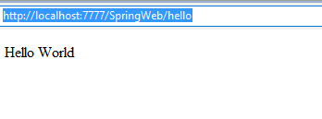
Expected Output

Slide 120
Create web project
Add spring core, and web capabilities
HelloWorld.java (Bean file)
HelloWorldServlet.java (Servlet Class)
springConfiguration.xml (Spring configuration file)
web.xml

Slide 121
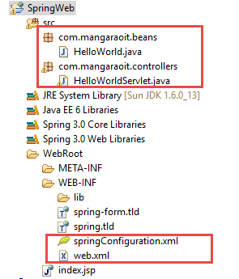
Directory Structure

Slide 122
HelloWorld.java
package com.mangaraoit.beans;
public class HelloWorld {
public HelloWorld(){
System.out.println("HelloWorld object is created");
}
private String message;
public void setMessage(String message){
this.message = message;
}
public String display(){
return message;
}
}

Slide 123
HelloWorldServlet.java
package com.mangaraoit.controllers;
public class HelloWorldServlet extends HttpServlet {
public void doGet(HttpServletRequest request, HttpServletResponse response)
throws ServletException, IOException {
response.setContentType("text/html");
PrintWriter out = response.getWriter();
ServletContext sc = getServletContext();
WebApplicationContext springContainer = WebApplicationContextUtils
.getRequiredWebApplicationContext(sc);
HelloWorld hw = (HelloWorld) springContainer.getBean("helloBean");
out.flush();
out.close();
}
}

Slide 124
SpringConfiguration.xml
<?xml version="1.0" encoding="UTF-8"?>
<beans
xmlns="http://www.springframework.org/schema/beans"
xmlns:xsi="http://www.w3.org/2001/XMLSchema-instance"
xmlns:p="http://www.springframework.org/schema/p"
xsi:schemaLocation="http://www.springframework.org/schema/beans http://www.springframework.org/schema/beans/spring-beans-3.0.xsd">
<bean id="helloBean" class="com.mangaraoit.beans.HelloWorld">
<property name="message" value="Hello World"/>
</bean>
</beans>

Slide 125
Web.xml
<servlet>
<servlet-name>spring</servlet-name>
<servlet-class>org.springframework.web.servlet.DispatcherServlet</servlet-class>
</servlet>
<servlet>
<servlet-name>HelloWorldServlet</servlet-name>
<servlet-class>com.mangaraoit.controllers.HelloWorldServlet</servlet-class>
</servlet>
<servlet-mapping>
<servlet-name>spring</servlet-name>
<url-pattern>/</url-pattern>
</servlet-mapping>
<servlet-mapping>
<servlet-name>HelloWorldServlet</servlet-name>
<url-pattern>/hello</url-pattern>
</servlet-mapping>
<context-param>
<param-name>contextConfigLocation</param-name>
<param-value>/WEB-INF/springConfiguration.xml</param-value>
</context-param>
<listener>
<listener-class>org.springframework.web.context.ContextLoaderListener</listener-class>
</listener>

Slide 126
Spring and Struts 2 Integration
Spring framework provides an easy way to manage the dependency. It can be easily integrated with struts 2 framework.
The ContextLoaderListener class is used to communicate spring application with struts 2. It must be specified in the web.xml file.
struts2-spring-plugin-x.y.z.jar is main jar which is required to integrate struts with Spring integration.
Steps to create the application:
Create struts2 application and struts2 spring libraries
In web.xml file, define ContextLoaderListener class.
In struts.xml file, define bean name for the action class.
In applicationContext.xml file, create the bean. Its class name should be action class name e.g. com.mangaraoit.Login and id should match with the action class of struts.xml file (e.g. login).
In the action class, define extra property e.g. message.

Slide 127
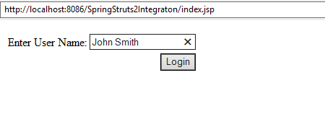
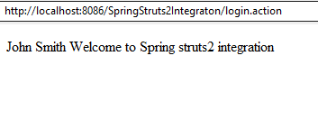

Slide 128
Example of Spring and Struts 2 Integration
index.jsp
web.xml
LoginAction.java
applicationContext.xml (should be under WEB-INF folder)
struts.xml
welcome.jsp

Slide 129
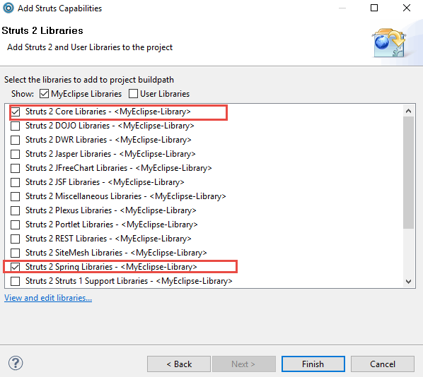
Add struts 2 core libraries and struts2 spring libraries

Slide 130
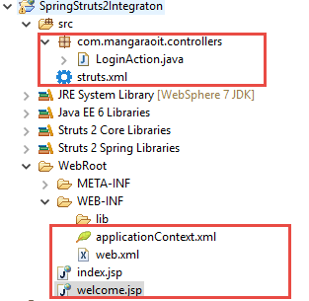
Directory Structure

Slide 131
index.jsp
<head>
<%@taglib uri="/struts-tags" prefix="s" %>
</head>
<body>
<s:form action="login">
<s:textfield name="username" label="Enter User Name"/>
<s:submit value="Login"/>
</s:form>
</body>

Slide 132
web.xml
<filter>
<filter-name>struts2</filter-name>
<filter-class>
org.apache.struts2.dispatcher.ng.filter.StrutsPrepareAndExecuteFilter
</filter-class>
</filter>
<filter-mapping>
<filter-name>struts2</filter-name>
<url-pattern>/*</url-pattern>
</filter-mapping>
<listener>
<listener-class>org.springframework.web.context.ContextLoaderListener</listener-class>
</listener>

Slide 133
LoginAction.java
package com.mangaraoit.controllers;
public class LoginAction {
private String username;
private String message;
public String getUsername() {
return username;
}
public void setUsername(String username) {
this.username = username;
}
public String getMessage() {
return message;
}
public void setMessage(String message) {
this.message = message;
}
public String execute(){
return "success";
}}

Slide 134
applicationContext.xml
<?xml version="1.0" encoding="UTF-8"?>
<beans xmlns="http://www.springframework.org/schema/beans"
xmlns:xsi="http://www.w3.org/2001/XMLSchema-instance" xmlns:p="http://www.springframework.org/schema/p"
xsi:schemaLocation="http://www.springframework.org/schema/beans
http://www.springframework.org/schema/beans/spring-beans-2.5.xsd">
<bean id="loginClass" class="com.mangaraoit.controllers.LoginAction">
<property name="message" value="Welcome to Spring struts2 integration" />
</bean>
</beans>

Slide 135
Struts.xml
Note: The only change here is instead of referring the com.mangaraoit.LoginAction class directly, we relate it using the bean name(loginClass) given in the spring bean configuration file
<?xml version="1.0" encoding="UTF-8" ?>
<!DOCTYPE struts PUBLIC "-//Apache Software Foundation//DTD Struts Configuration 2.1//EN" "http://struts.apache.org/dtds/struts-2.1.dtd">
<struts>
<package name="default" extends="struts-default">
<action name="login" class="loginClass">
<result name="success">welcome.jsp</result>
</action>
</package>
</struts>

Slide 136
welcome.jsp
<%@ taglib uri="/struts-tags" prefix="s"%>
Welcome, <s:property value="username"/><br/>
${message}

Slide 137
Spring MVC Interview Questions

Slide 138
What is the front controller class of Spring MVC?
The DispatcherServlet class works as the front controller in Spring MVC.

Slide 139
What does @Controller annotatio
The @Controller annotation marks the class as controller class. It is applied on the class.

Slide 140
What does @RequestMapping annotation?
The @RequestMapping annotation maps the request with the method. It is applied on the method.

Slide 141
What does the ViewResolver class?
The View Resolver class resolves the view component to be invoked for the request. It defines prefix and suffix properties to resolve the view component.

Slide 142
Which ViewResolver class is widely used?
The org.springframework.web.servlet.view.InternalResourceViewResolver class is widely used.

Slide 143
Does spring MVC provide validation support?
Yes

